Slide 1

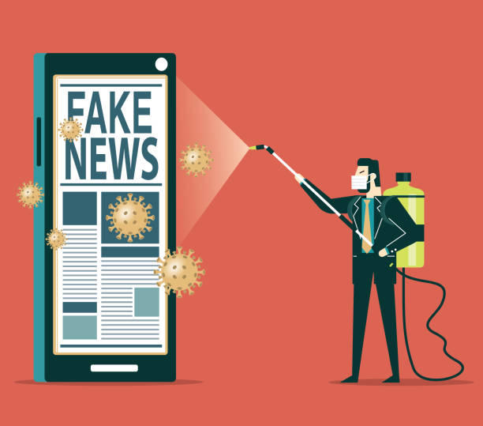
Fake News Detection website
By : Mihir Mandviya
Tushar Soni

Slide 2
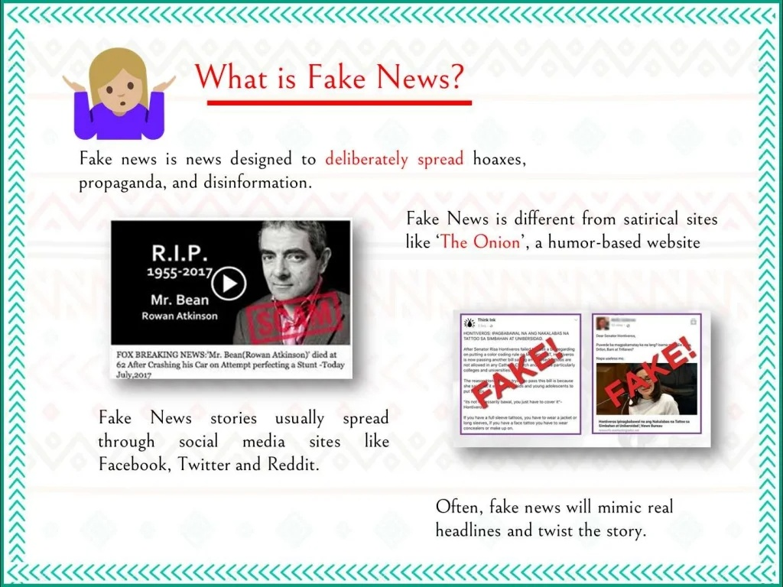


What is Fake News?
Fake news is a news designed to deliberately spread hoaxes, propaganda and disinformation.
Fake News stories usually spread through social media sites like WhatsApp, Facebook, Twitter and Instagram.
Often, fake news will mimic real headlines and twist the story.

Slide 3
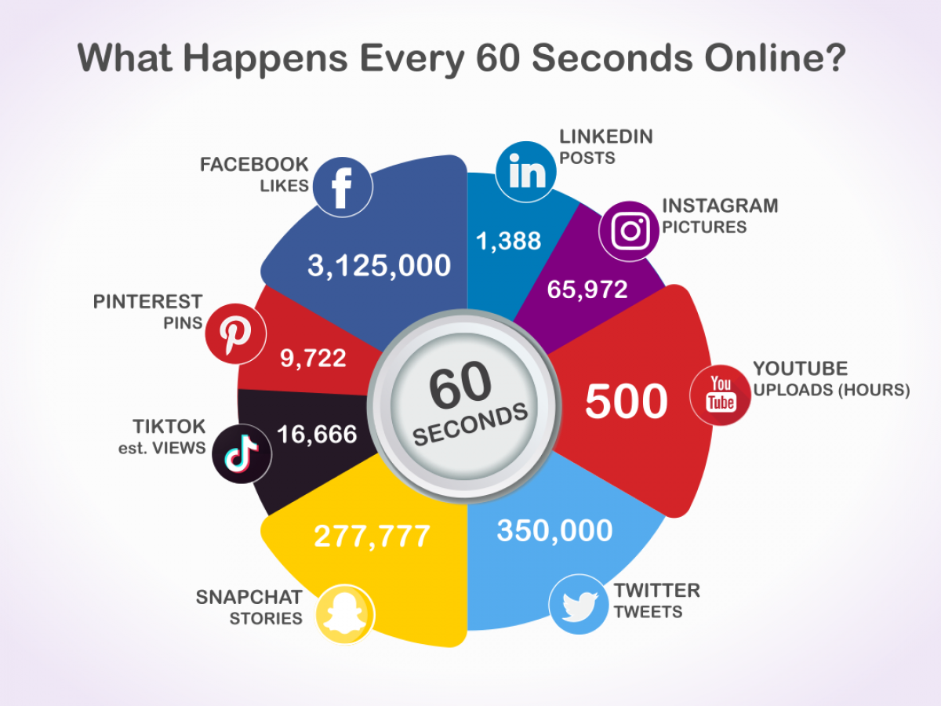
Why is detecting fake news so important?

Slide 4
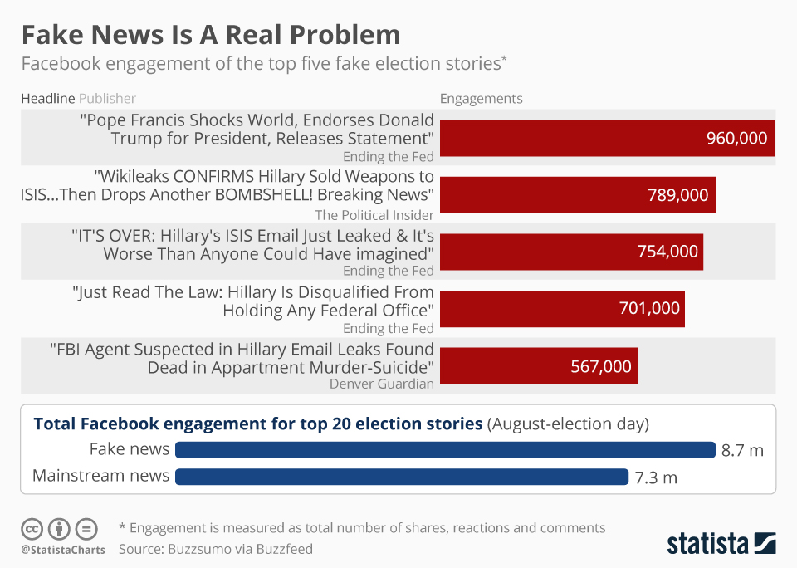

Slide 5

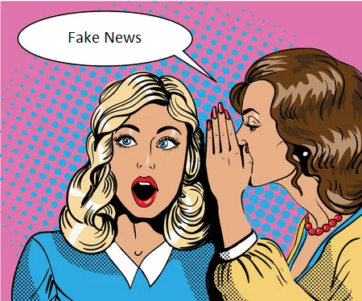


Not only do we struggle to determine if articles are telling us the truth, but marketers try to hook us up with all kinds of products that are just what we need because they are better than competition, the safest, the only one that will get you your desired results.

Slide 6
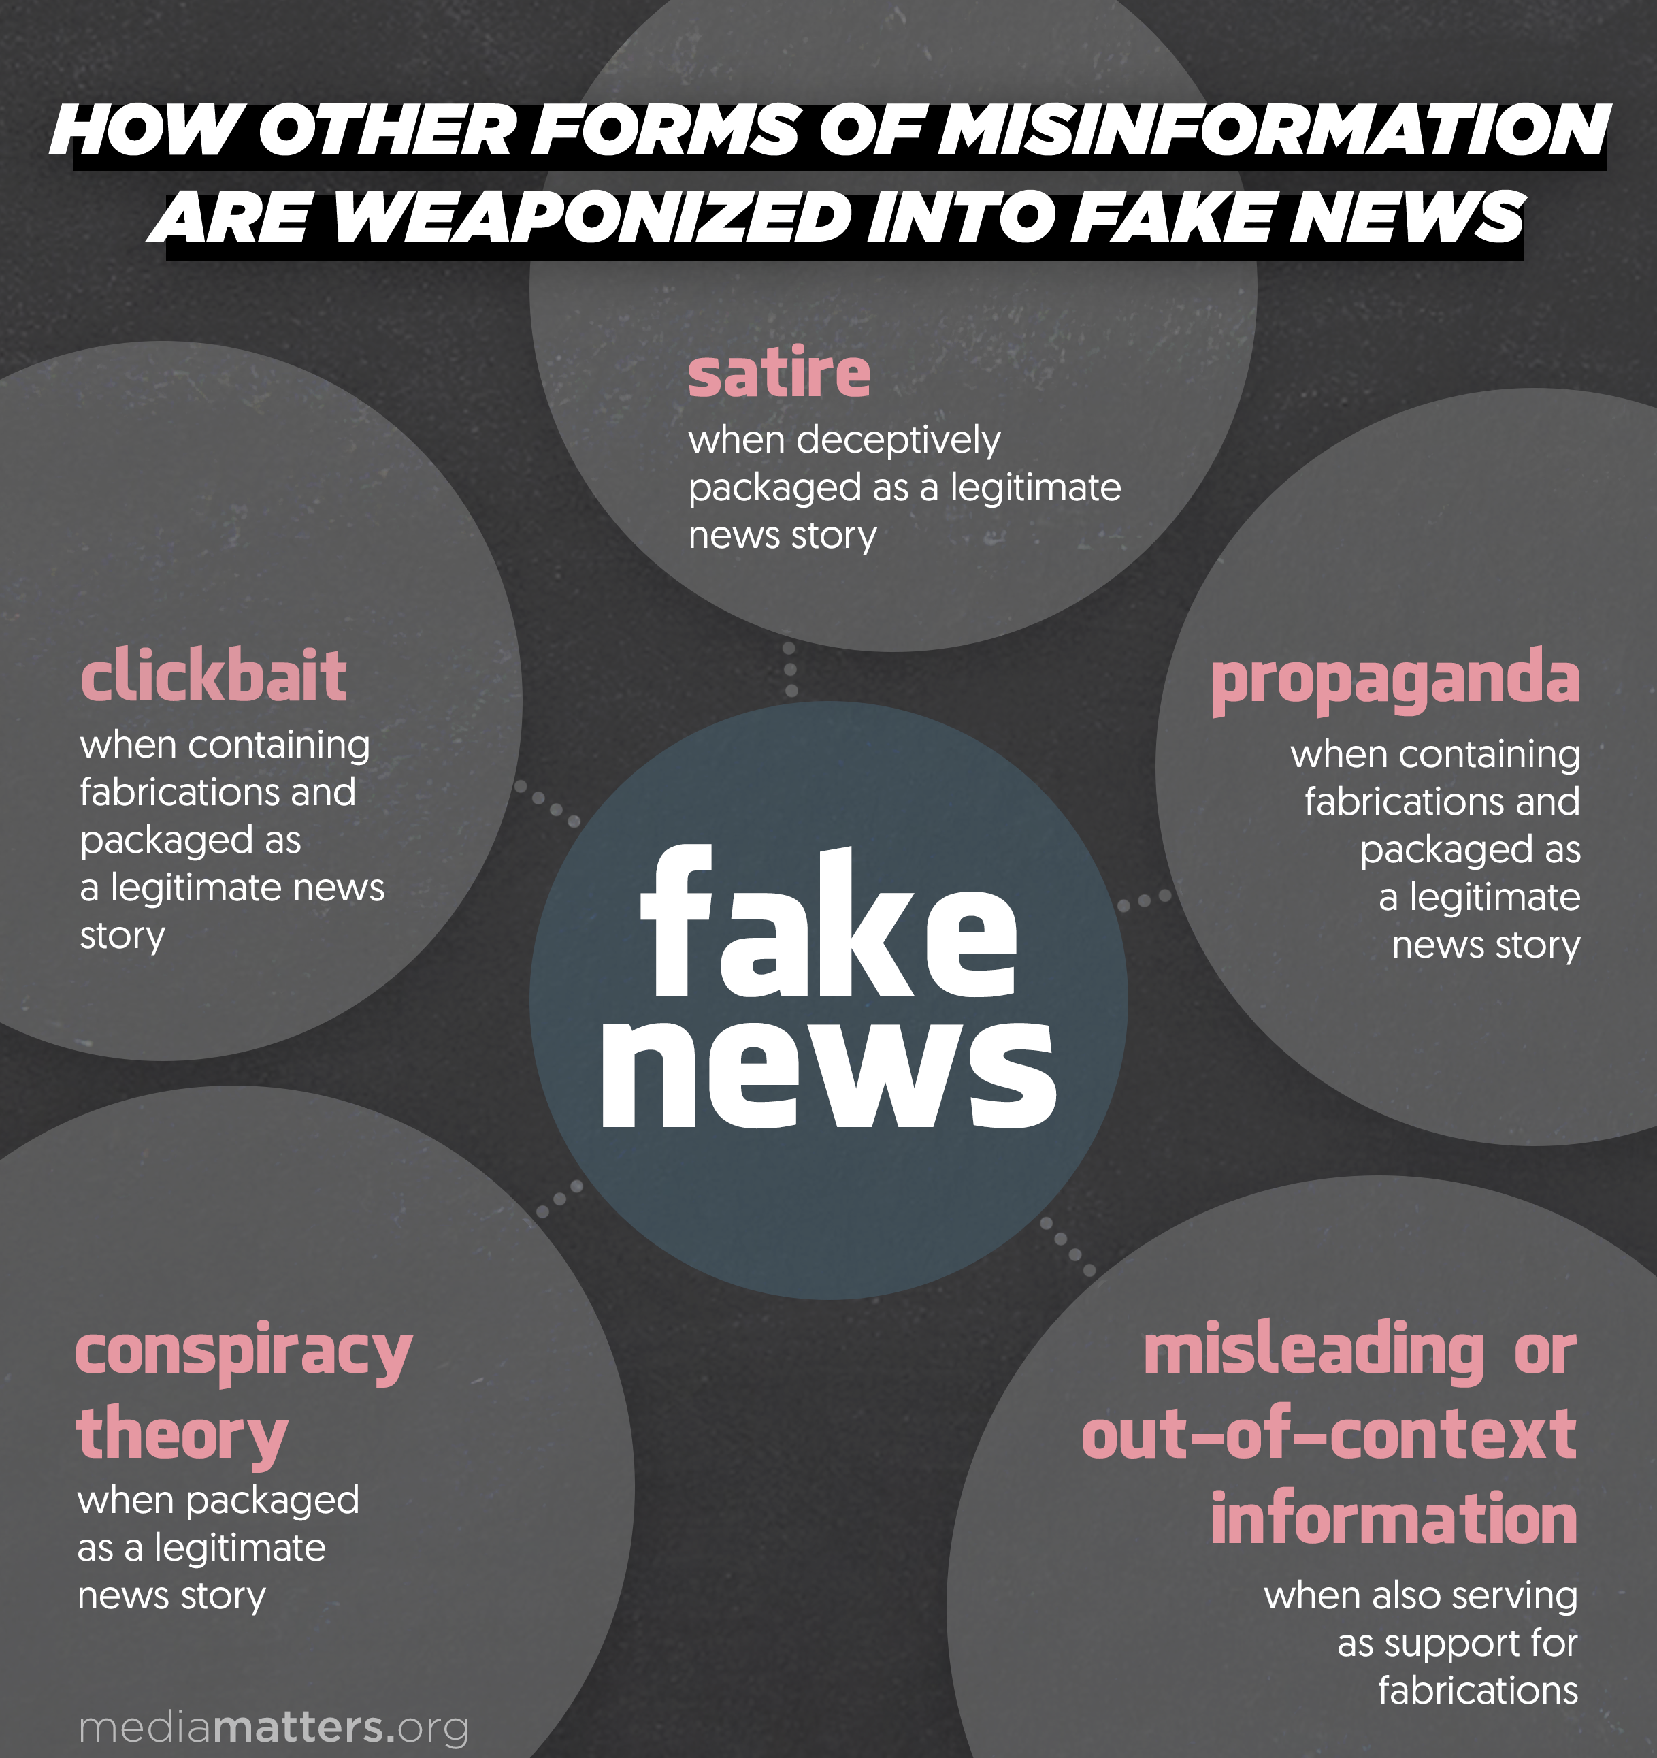
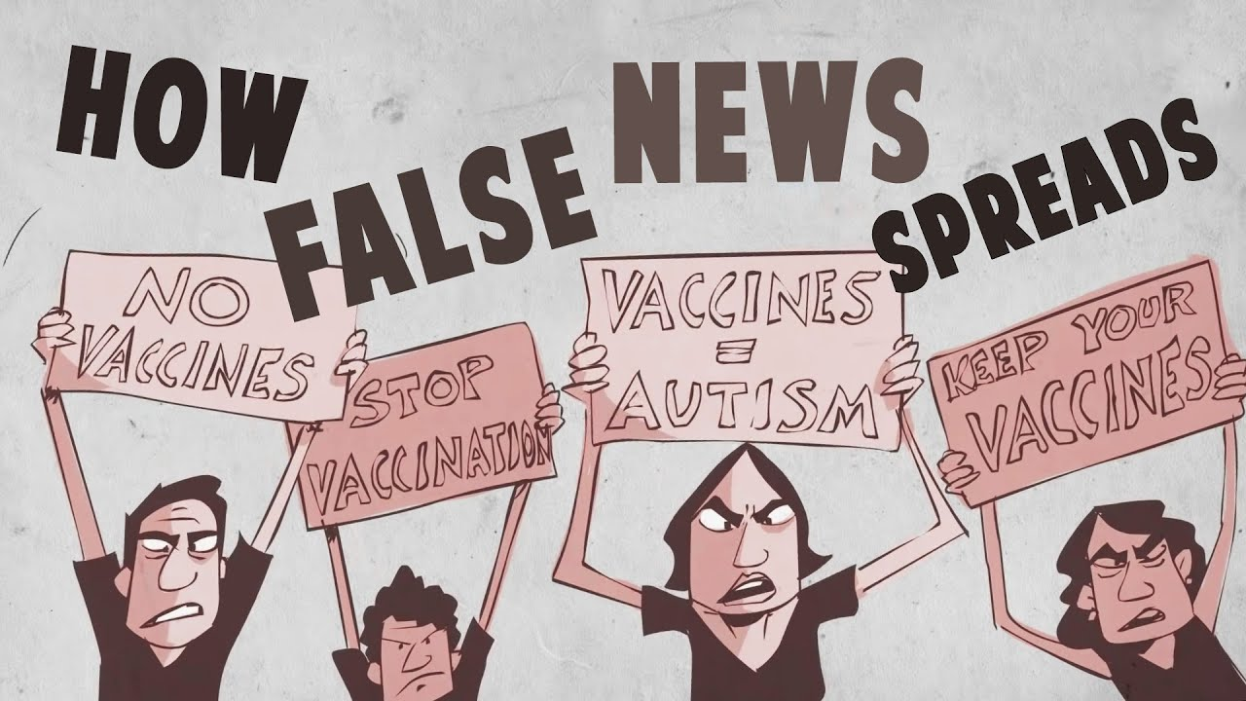
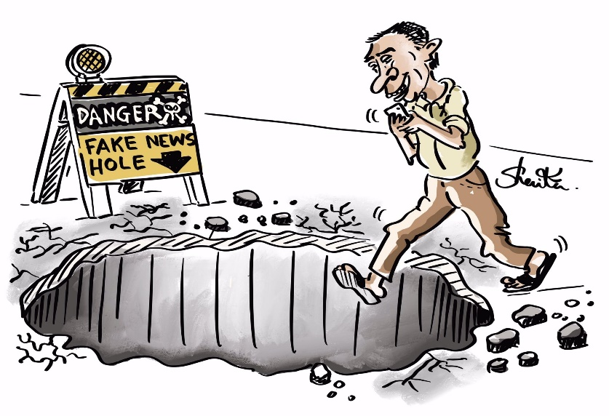
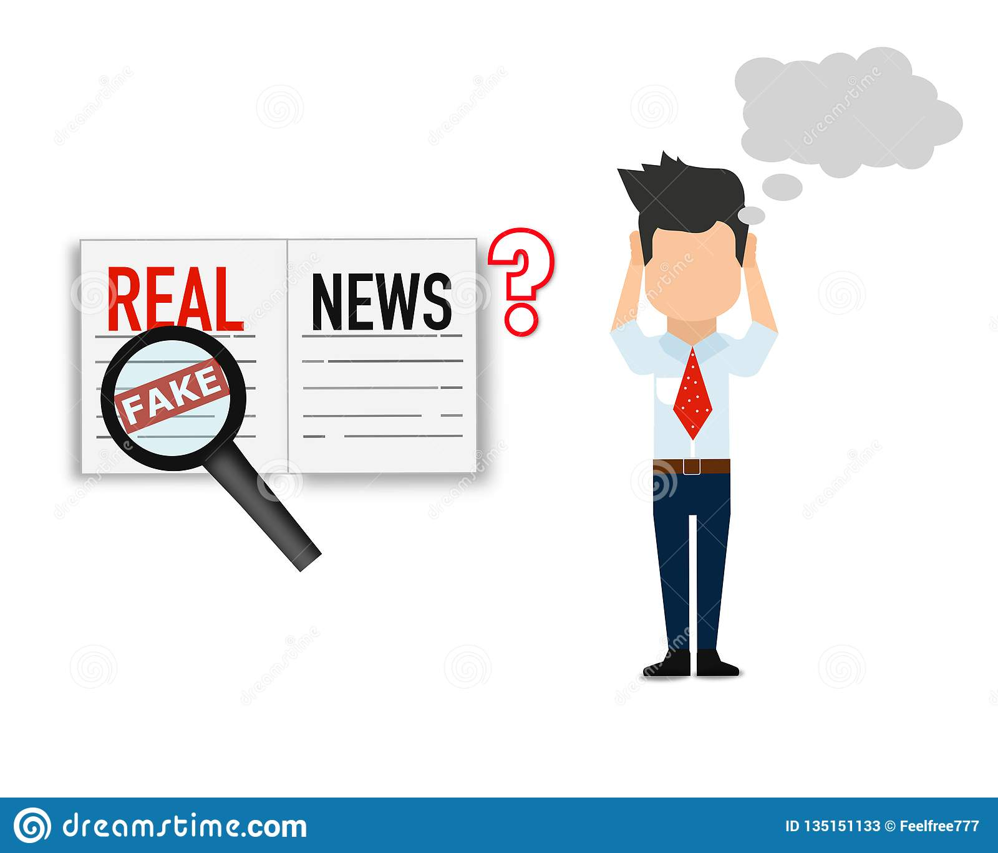


Slide 7
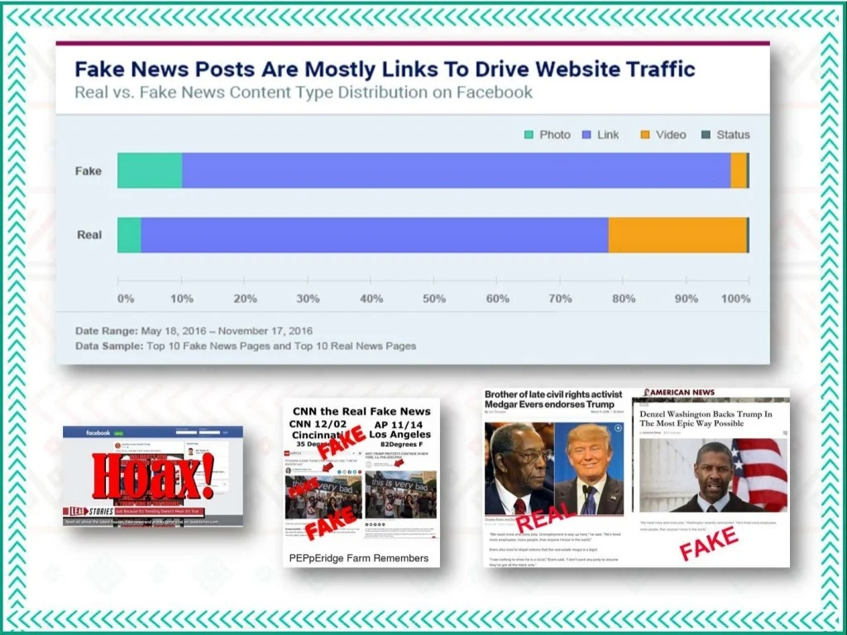

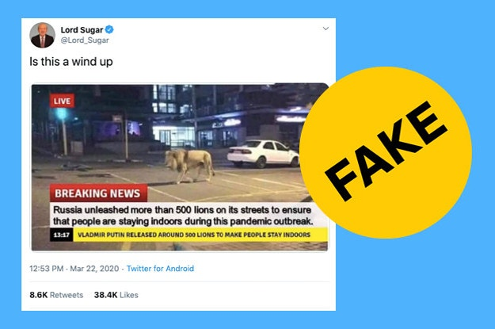


Slide 8
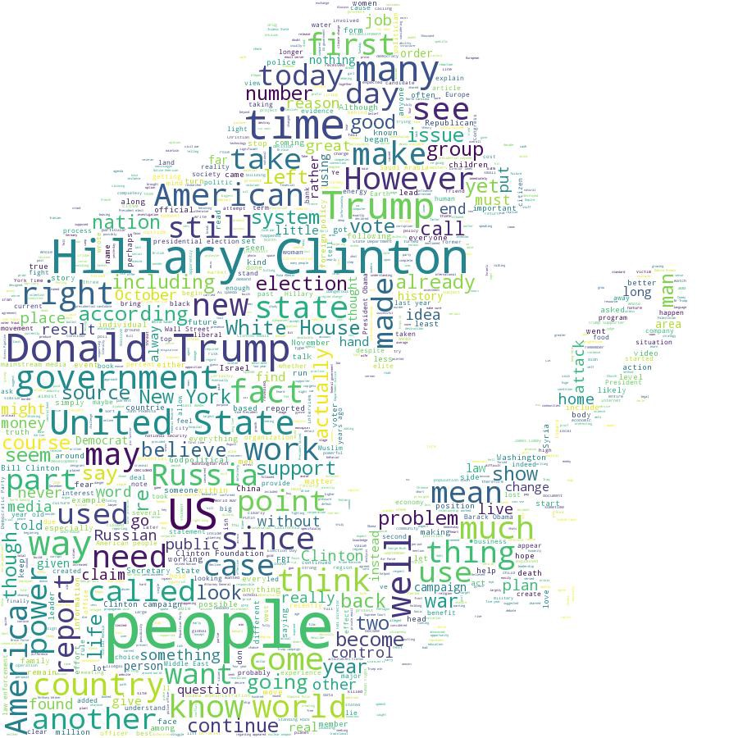
Given today's volume of news data, it is possible to teach a computer how to read and understand the differences between real news and fake news using Machine Learning (ML). The building blocks of our model are Data Set and Machine Learning Algorithms. First Machine Learning Algorithm will remove all the stop words from the headline, then it will apply stemming to remove suffix and prefix after that tokenization process will come into the picture and will create meaningful data then at last with the help of normalization we will create confusion matrix to predict whether given news is real or fake.
Detecting Fake News with Machine Learning(ML)

Slide 9
THANK YOU…!!!

